Slide 1




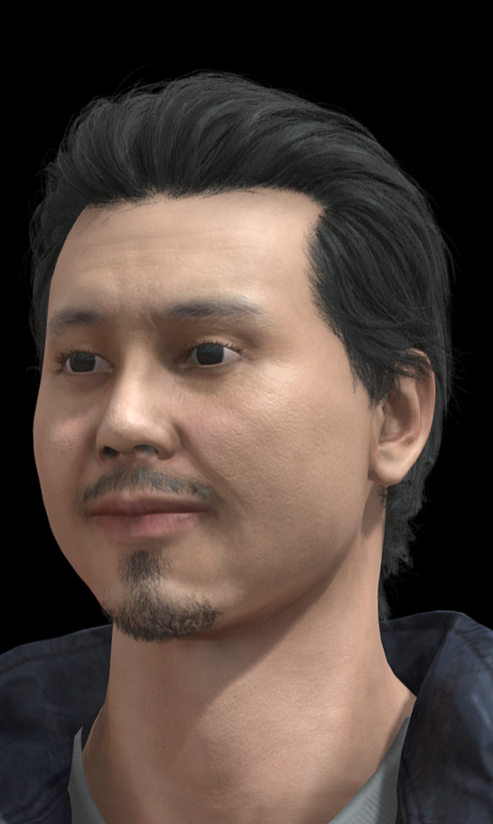
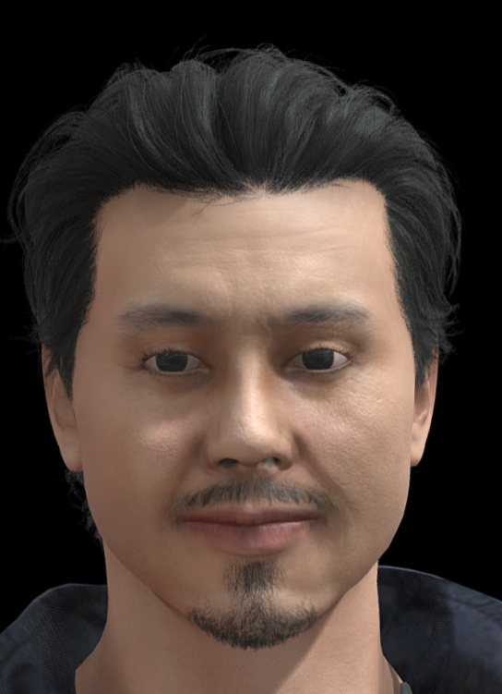
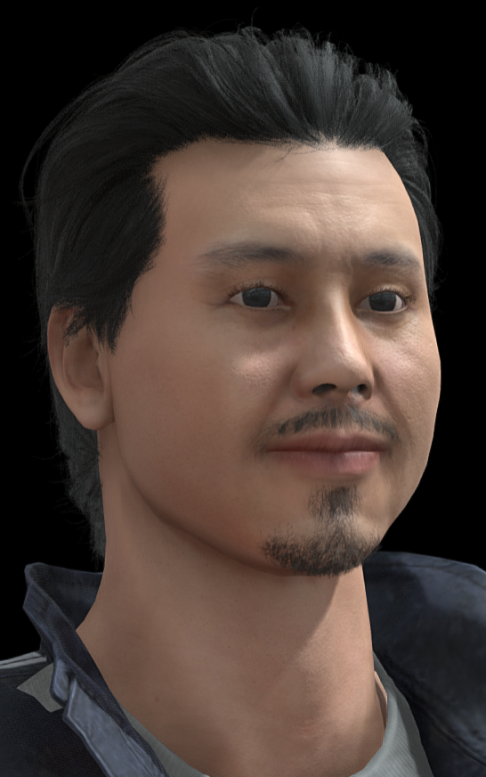




How to Play
Apple Frenzy
Remember to have Fun!
记得玩得开心
1. | Use your Nose to move the Glove! 用鼻子移动手套！
2. | Apples will Fall from the Tree! 苹果将​​从树上掉下来！
3. | Pick up the Red Apples! 快来摘红苹果吧！
4. | Avoid the Grey Apples! 避免灰苹果！
+1
-1

Slide 2

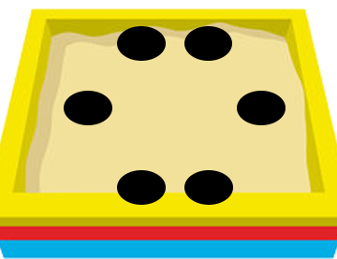




How to Play
Step Upright
Remember to have Fun!
记得玩得开心
1. | Use your nose to control the hammer! 用鼻子控制锤子！
2. | Moles will appear from the holes! 痣会从洞里出现！
3. | Hit the Evil Moles! 打击邪恶的鼹鼠！
4. | Avoid the Cute Moles! 避开可爱的鼹鼠！
+10
-10

Slide 3








How to Play
Beach Bomb
Remember to have Fun!
记得玩得开心
1. | Turn your Head left and right! 左右转动你的头！
2. | Enemies will fire Balls at you! Avoid them! 敌人会向你发射球！避开他们！
3. | Walk the entire plank before Time runs out! 在时间用完之前走完整条木板！
UNCOMPLETE

Slide 4
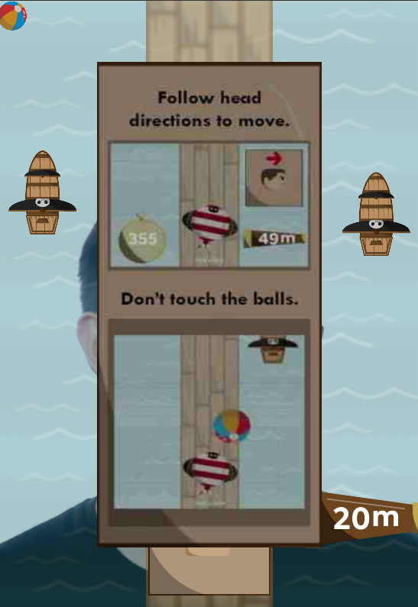
How to Play - SingaBall
Turn your head left and right to Walk!
左右转动你的头来行走！
Walk the Plank in the shortest time!
用最短的时间走完平板支撑！
Avoid the Beach Balls!
避免沙滩球！
Get the highest score before time runs out!
在时间用完之前获得最高分！
SAMPLE

Slide 5
Sources
Art Assets taken from the games.
Translation by Google Translate
Asian man 3d model reference: https://sketchfab.com/3d-models/asian-man-a27942dce64a42a4ac613b30f5ad92d4

